Slide 1

Uppwise SPM Demo Cycle

Slide 2

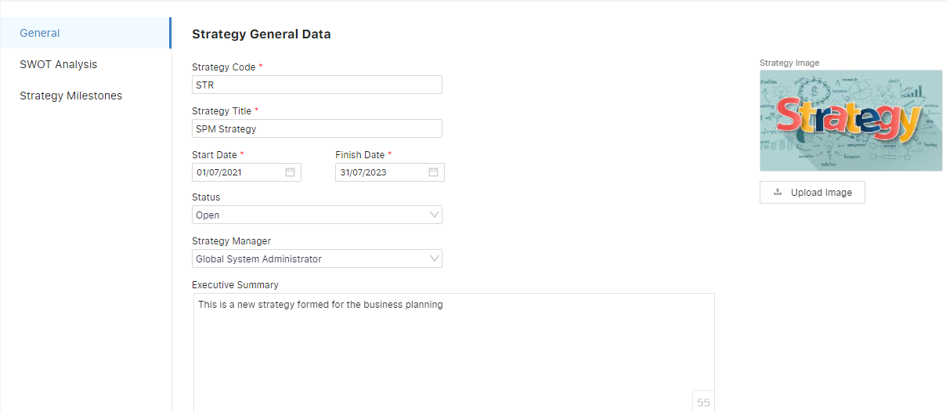

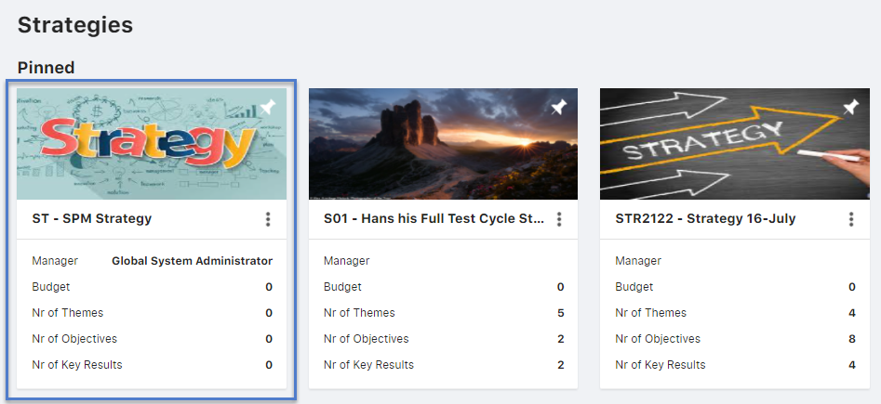
Creation of Strategy
Over the strategy module in the application, the user can redirect to Strategies and from the create button the form will be displayed to fill in information and upon save the strategy is displayed over the register.

Slide 3
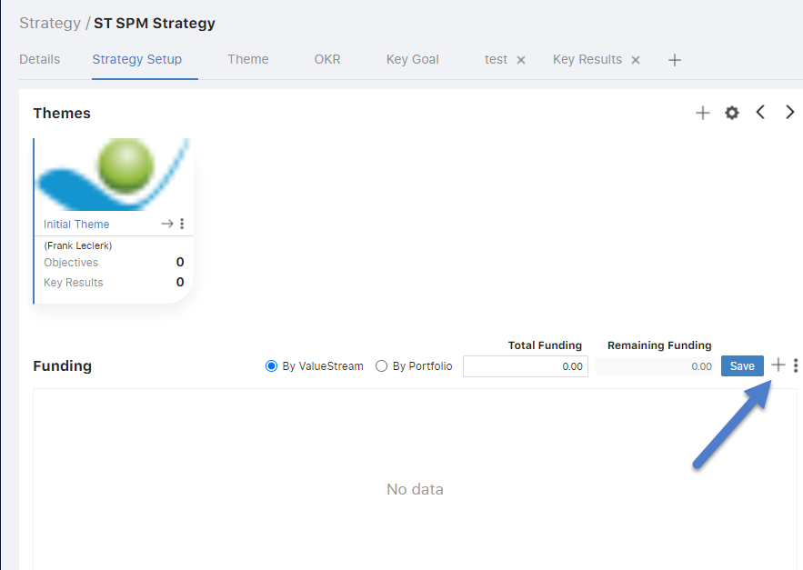
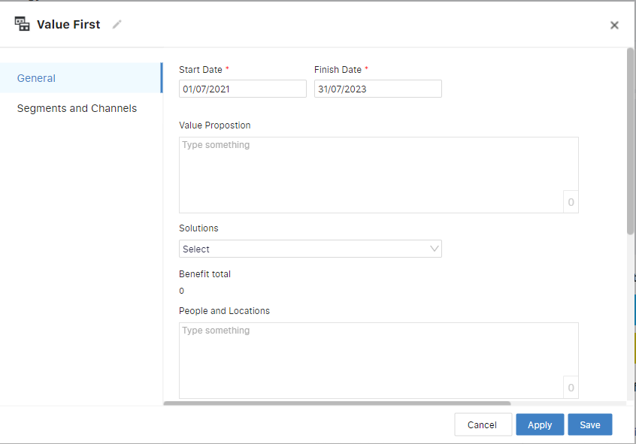

Strategy- Strategy Setup Tab
When selected the card of created strategy, in the strategy setup tab the user can click over the create button at the bottom where the value streams can be created by filling in the information.

Slide 4
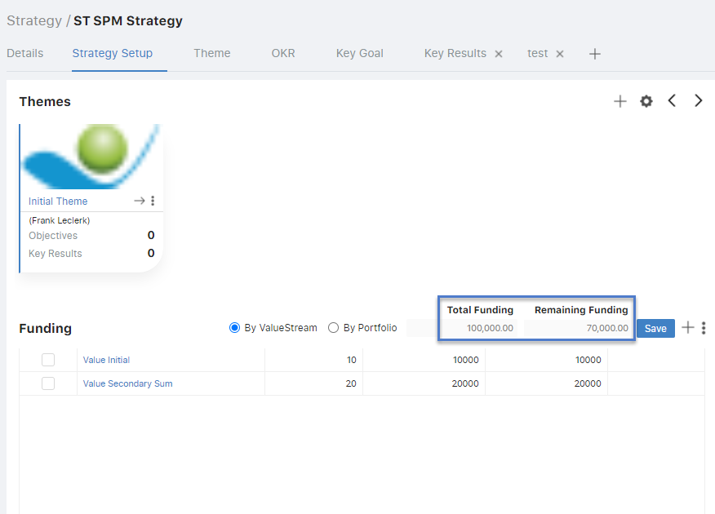
Strategy- Strategy Setup Tab
Here, for the value stream the total funding amount can be defined and the user can accordingly allocate the percentage value for the same. As the value streams will be included the calculation of remaining funding will be automatically be calculated.

Slide 5
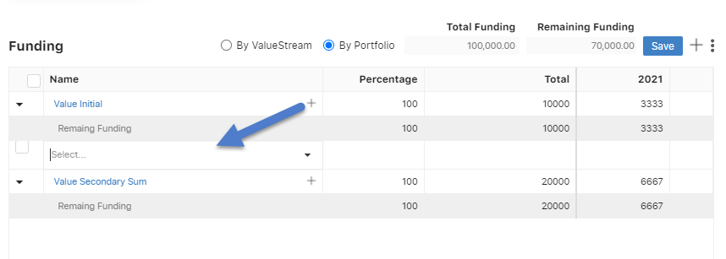

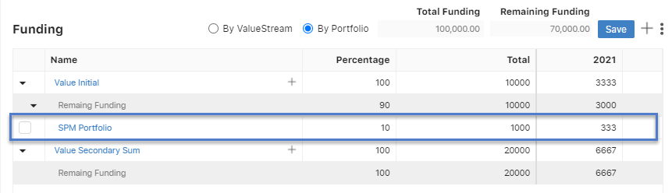
Strategy- Strategy Setup Tab
Now, to associate a portfolio the user can select the in the same funding widget and by clicking over
Button in the grid can select the portfolio from the drop down to be associated by defining it’s percentage value too

Slide 6
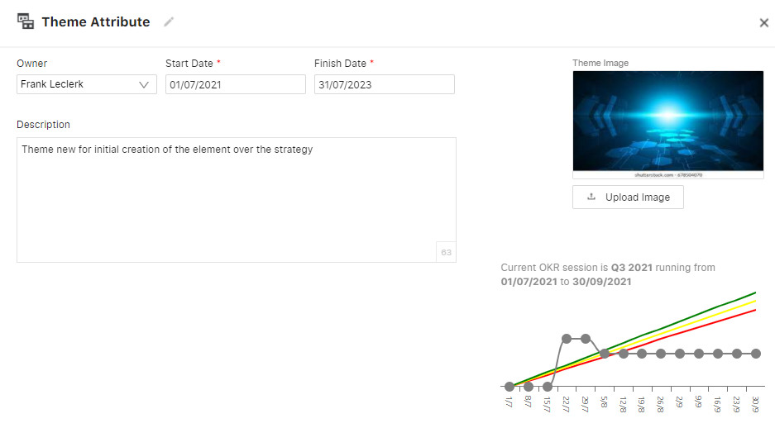
The Theme can be created over the Themes layout by clicking on the button and defining details over the pop up of the same in the strategy.
Creation of Theme Strategy

Slide 7
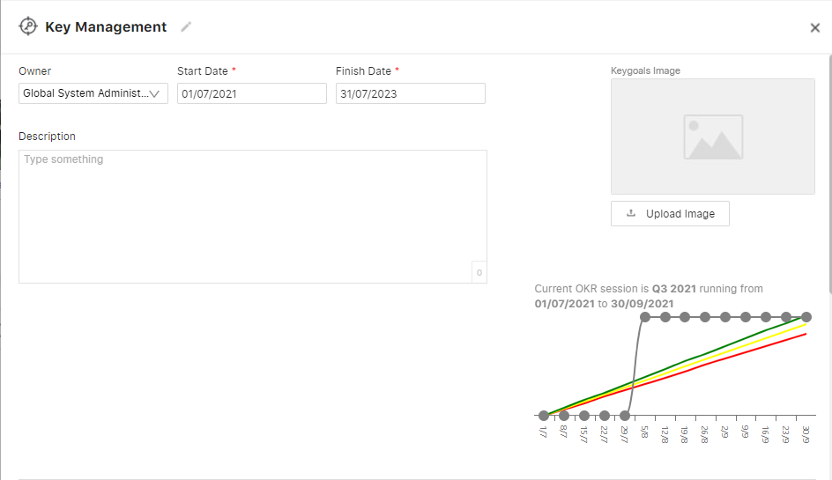
The Key goals can be created in the Key goals layout by clicking over the button and by filling in the details the same can be created. Also, from the strategy Setup layout, from the key goal grid at the same ca be defined
Creation of Key Goals Strategy

Slide 8
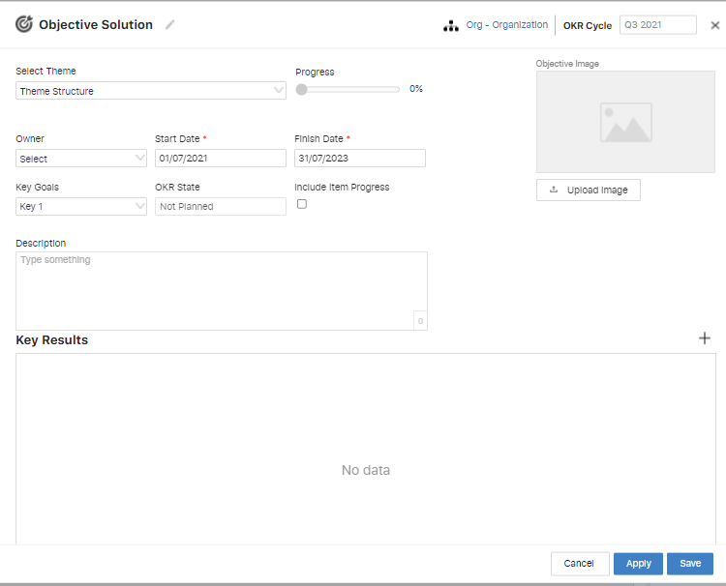
The theme can be selected for an objective from the ‘Select theme’ drop down to associate the same.
The key goals can be selected for an objective from the ‘Key goals’ drop down to associate the same.
The Objective can be created over the Themes layout by clicking on the button and defining details over the pop up of the same in the strategy.
Creation of Objective Strategy

Slide 9
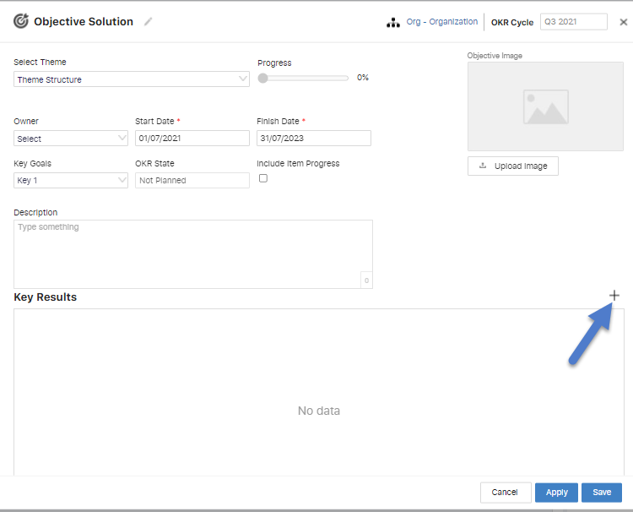
The Key result can be created in the Themes layout under the Objective defined by clicking over the three dot menu and defining the details for the same or by opening the form pop up of objective and clicking over button.
Creation of Key Result Strategy

Slide 10
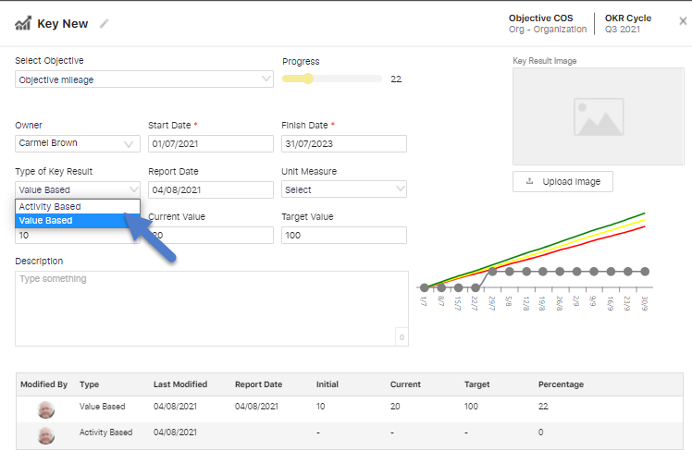
Progress of Objective
Once the key result is created the progress for objective is defined through the same. And the key result value can be defined in to types
Activity based- The progress bar over the key result pop up can be moved to define the progress.
Value based- where the progress can be defined by entering the Initial and the Current value and based upon which the chart will be displayed.

Slide 11
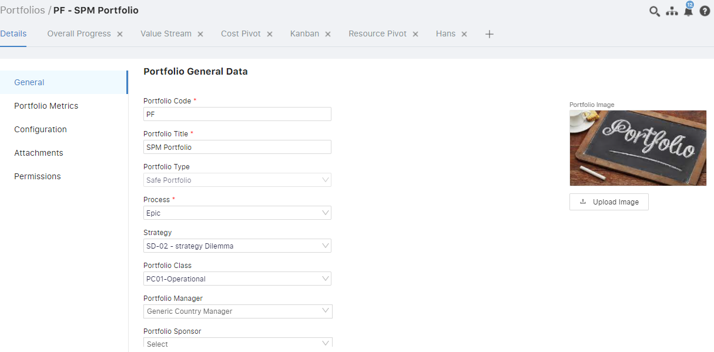
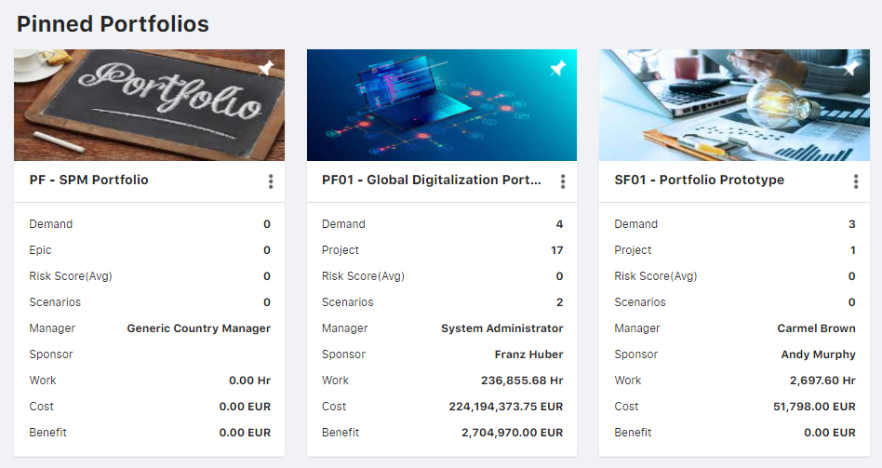
Creation of Portfolio
Over the portfolio module in the application, the user can redirect to Portfolios and from the create button the form will be displayed to fill in information and upon save the portfolio is displayed over the register.

Slide 12
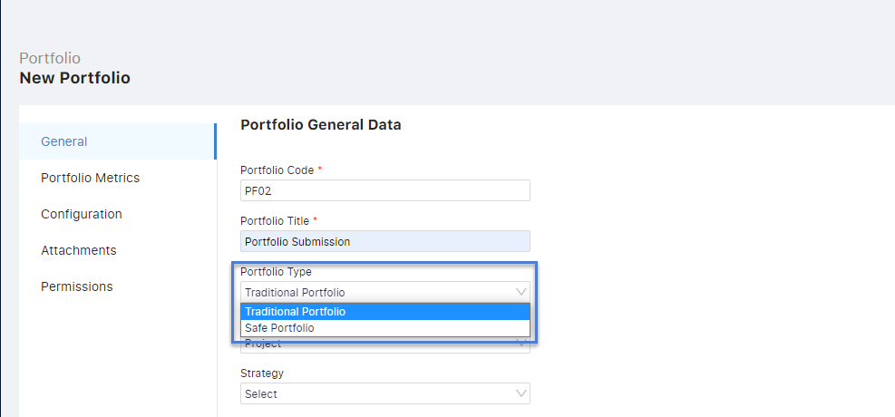
Portfolio types
The user has the facility to create two types of portfolio and respectively that particular type of Item can be included into the same.
Traditional Portfolio - Can include Project type Items
Safe portfolio - Can include Epic type Items

Slide 13
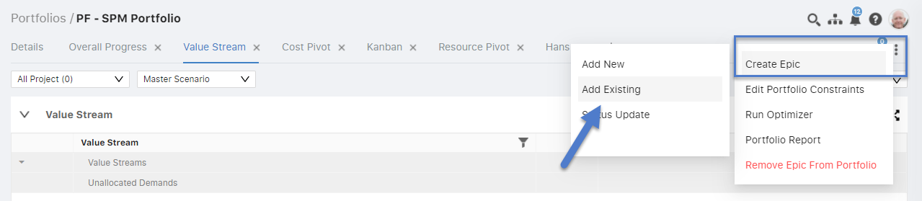
Portfolio – Association of Items
The user can redirect over the Portfolio workspace where from three dot menu can add items in the portfolio, can either create a new project or add an existing one.

Slide 14

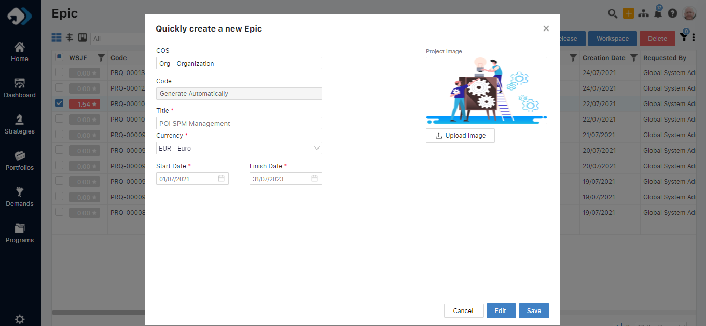
Creation of Item
The item can be created by clicking over the create button over at the top of the application in the right. The mandatory details can be filled and on clicking over the save button the item would be created.

Slide 15
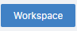
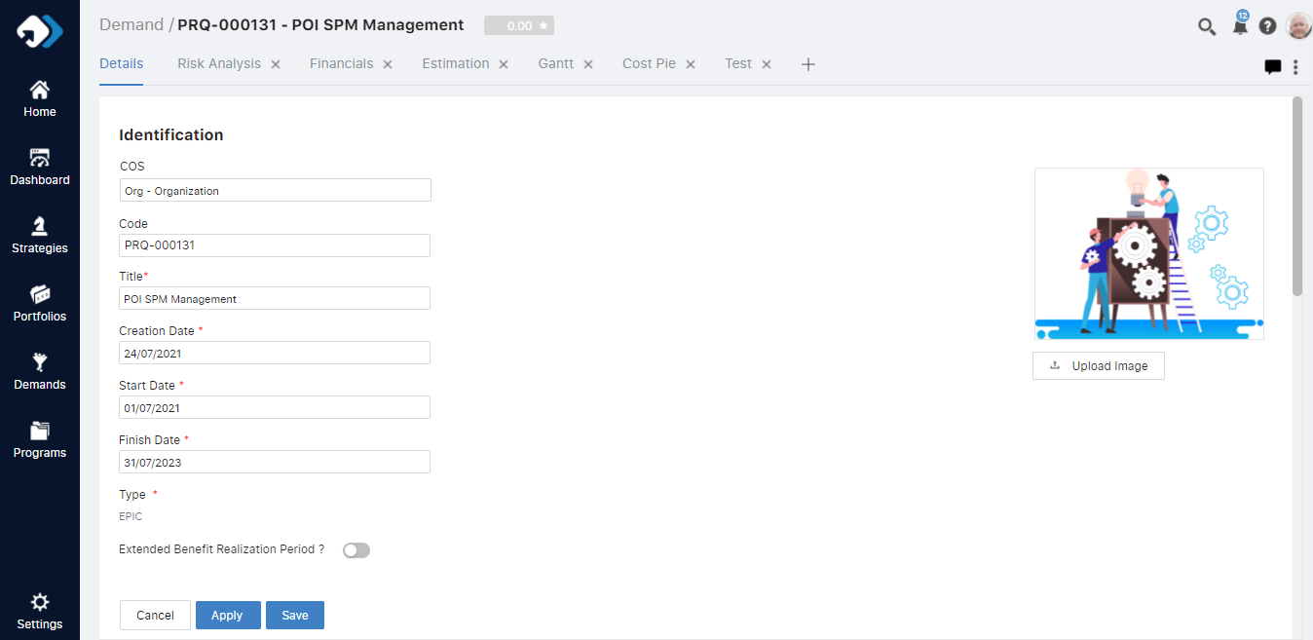
Filling in Item Details
The Item details can be entered by user by clicking over the title or by selecting the Item and clicking over
button. All fields can be filled by user over the details tab for filling the information for the same.

Slide 16
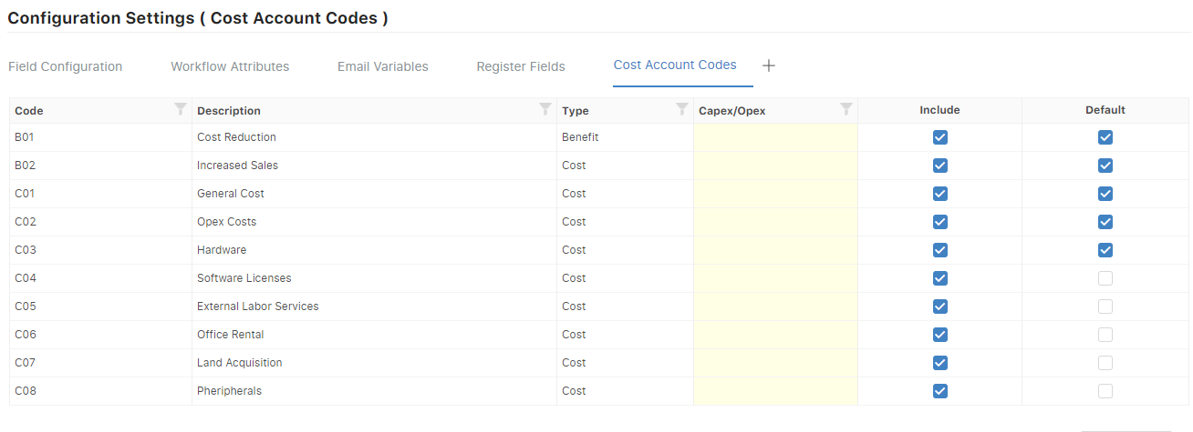
Configuration for Costs
The cost elements over the Item can be displayed on the basis of the settings done over the configuration of the form in company settings. The same values can be set to be Included or set as default when the project is created and accordingly the data in the workspace can be seen.

Slide 17

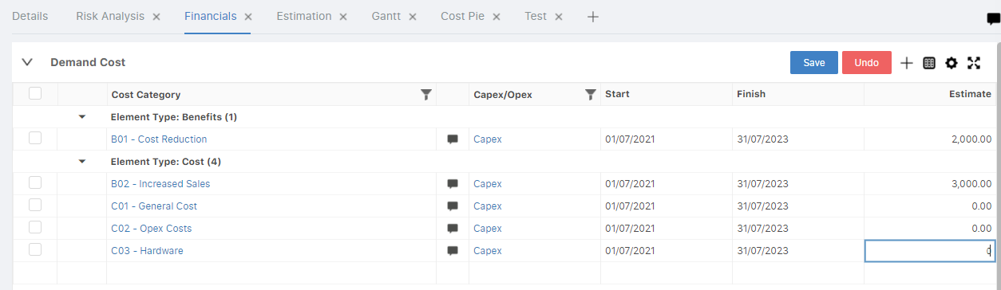
Item Workspace - Cost Widget
For assigning the cost the Financial layout can be selected and in the cost details grid can click over button to include cost in the item

Slide 18
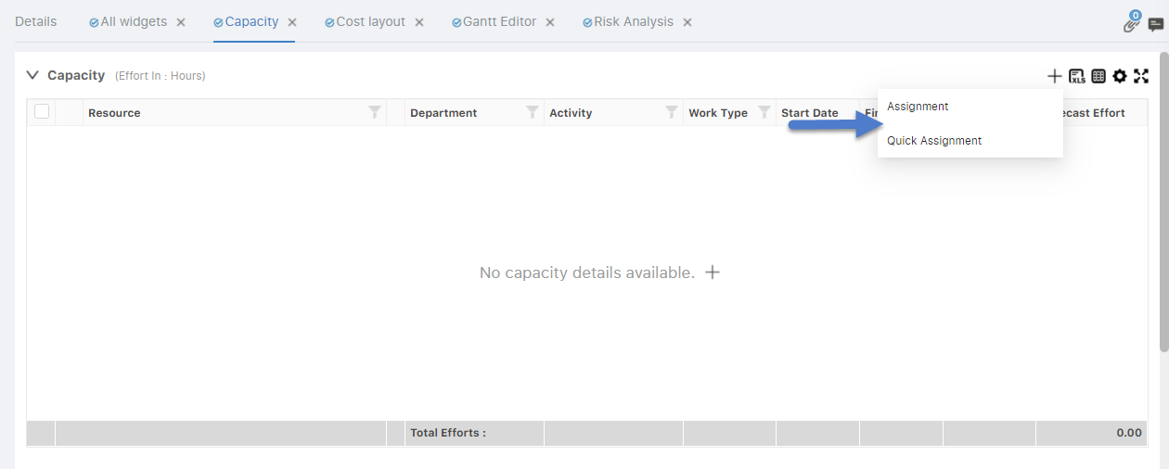
Item Workspace - Capacity Widget
The resource can be assigned in two ways one:
Assignment
Quick Assignment

Slide 19
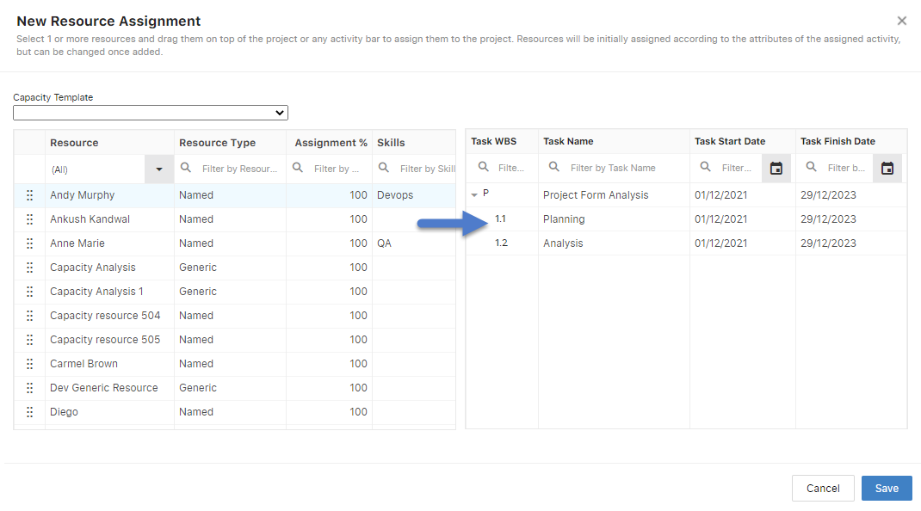
Item Workspace - Capacity Widget(Assignment)
In resource assignment from the pop up displayed the resources both named and generic can be drag and dropped to be associated on the respective activity.

Slide 20
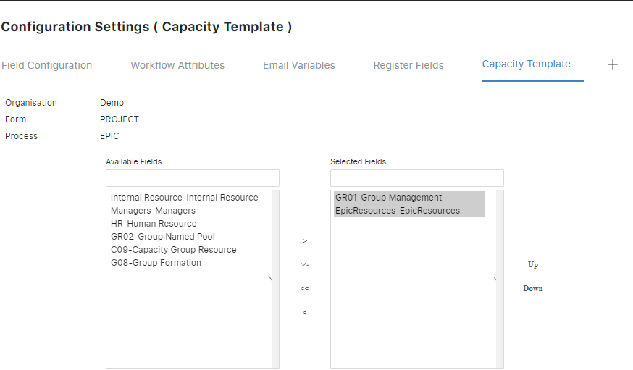
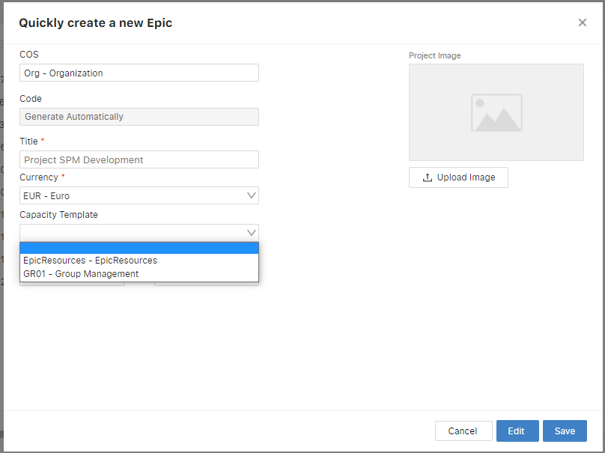

Configuration for Capacity Template
The resources can be associated in a group that can be created over Capacity Template in the company settings and accordingly from configuration setting the set of resources can be selected to be included for association at the time of Item creation.

Slide 21
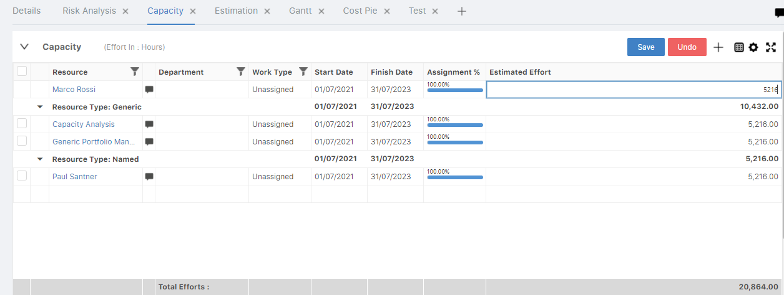
Item Workspace - Capacity Widget(Quick Assignment)
For assigning the resource the Capacity layout can be selected and in the cost details grid can click over button to include cost in the Item from the quick assignment option.

Slide 22
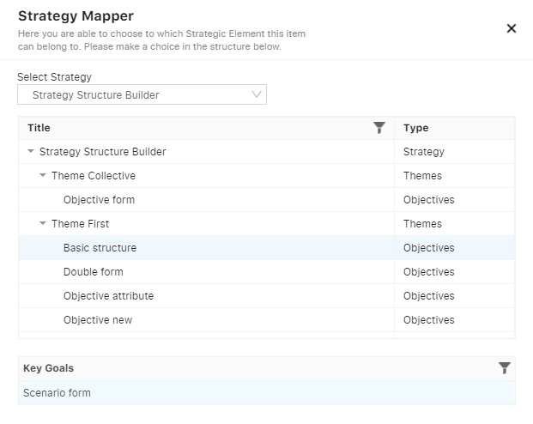
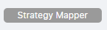

Item Mapping with strategy
The respective item can be associated with a strategy by selecting the Strategy Mapper option in Item details or workspace and can select the respective strategy to be mapped with the Item.

Slide 23
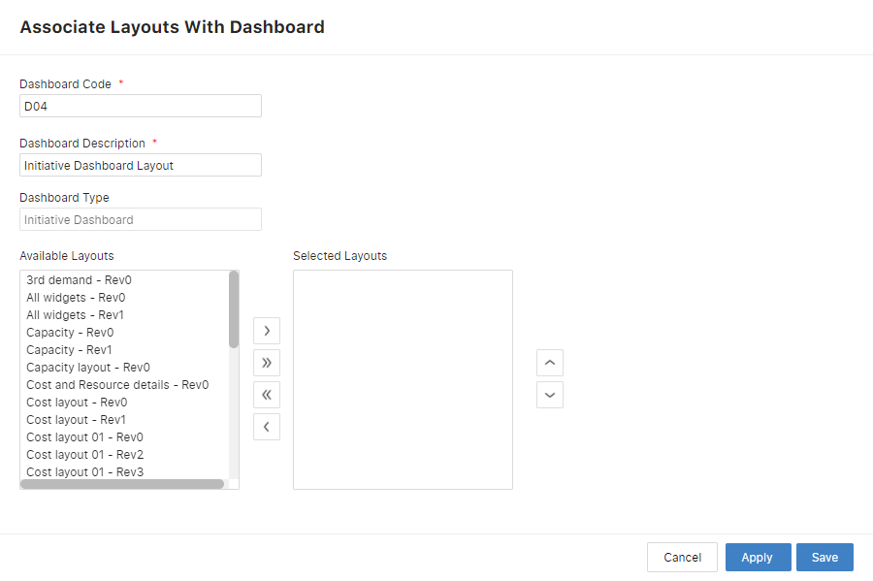
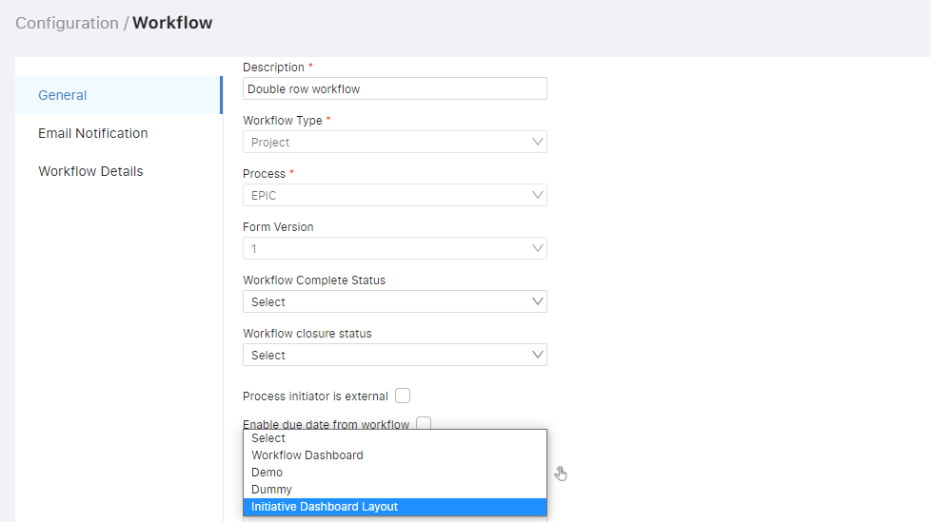
Published Dashboard
There are two types of Dashboard which can be associated with the modules like Initiatives, Portfolios, Strategy etc.
Master Workflow Dashboard
Module Dashboard
The master dashboard which is created by the user is associated with the workflow of the same. It can be associated in the workflow form to be viewed in the workspace of the respective module.

Slide 24
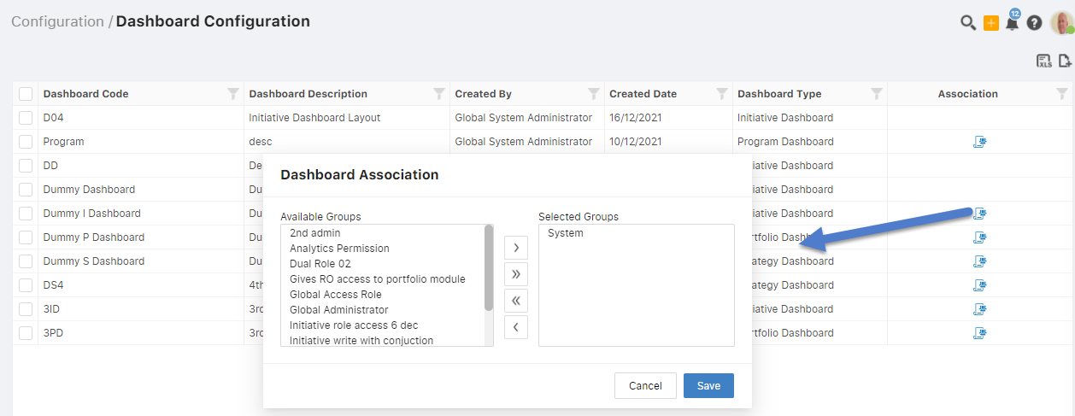
Published Dashboard
Module Dashboard
The module dashboard when created can be associated with the roles for which it has to be accessible with.

Slide 25
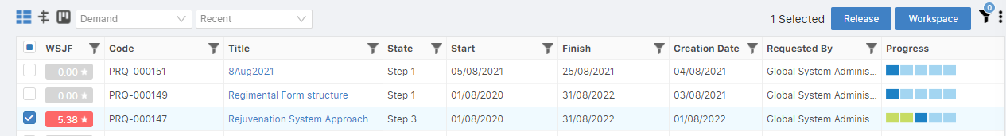
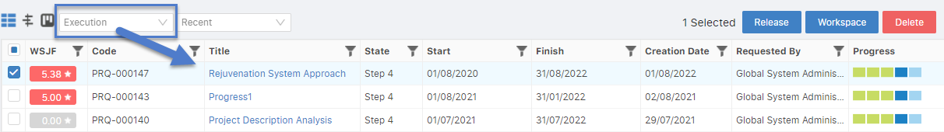
Item Workflow
The item created by user can be released to the execution phase by releasing it from the register or through the workflow management in item details page.
The item where they are enabled to be displayed in execution phase can be viewed by selecting the drop down at the top left of the page with the ‘Execution ‘ option.

Slide 26
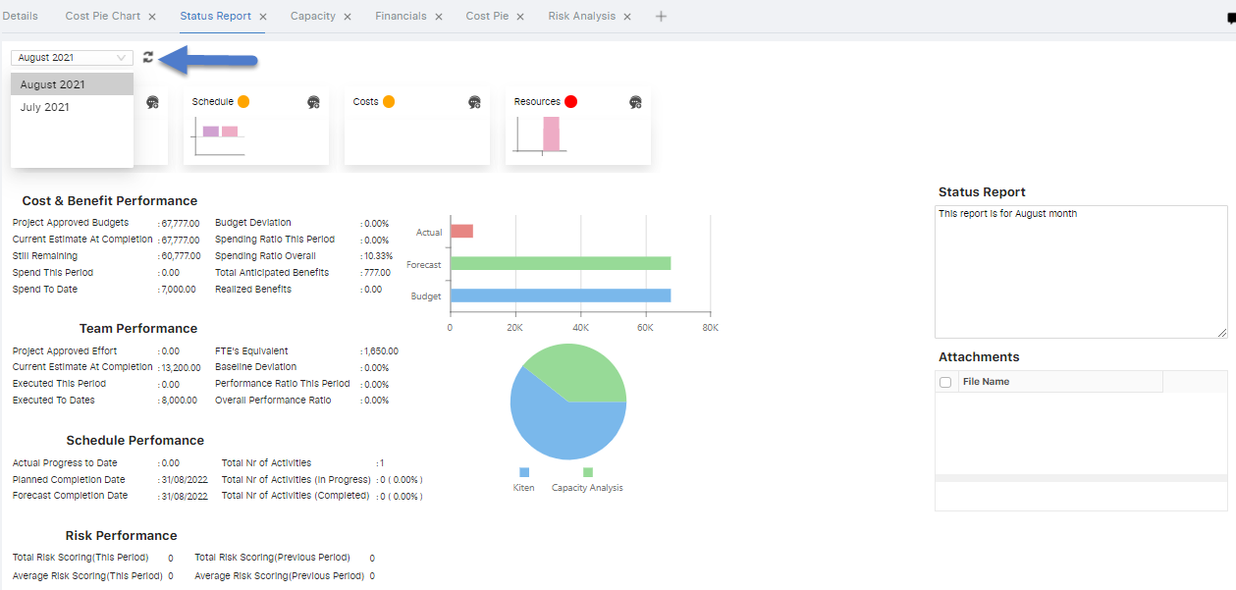
Creation of Status Report
The item when is in the execution phase then the status report for it can be created for the 2 periods, i.e. current month and previous month respectively.
Respectively these values can be synced into the status report:
Cost and Benefit
Capacity
Schedule
Risk

Slide 27
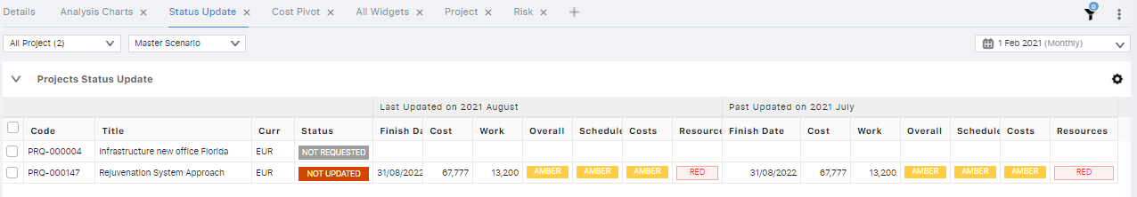
Item Progress Data over Portfolio
The item in execution phase can be verified over the Portfolio in which it is associated in. Also, the same data that is created over the project would be displayed in the portfolio too in the status update widget.

Slide 28
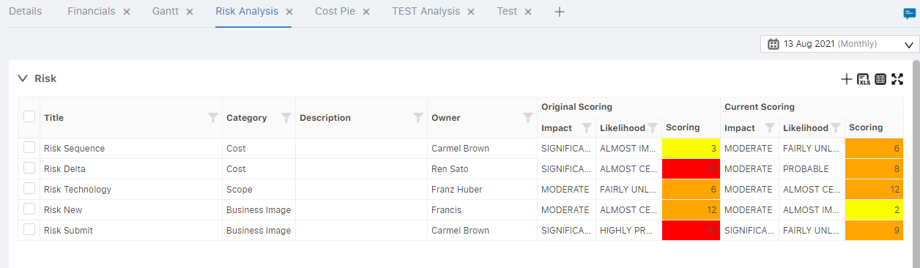
Item – Risk
In the demand, the risk can be created by adding new risk details and accordingly it’s score is calculated. The same matrix is displayed in the portfolio in which the item is associated with.

Slide 29
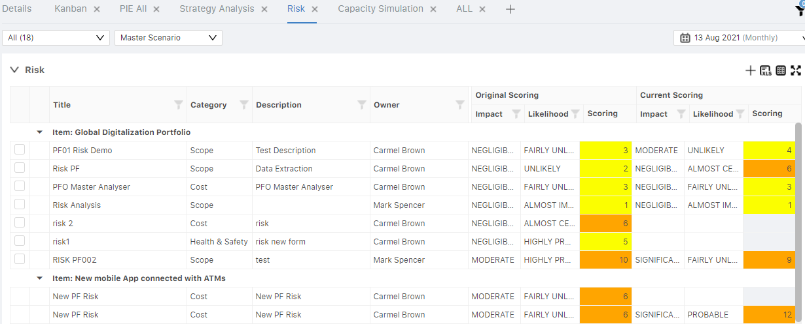
Portfolio – Risk
In the portfolio, the risk that are created over the projects associated with it are displayed here and the calculation for the it is displayed accordingly in. Also, new risk can be included over the grid.

Slide 30
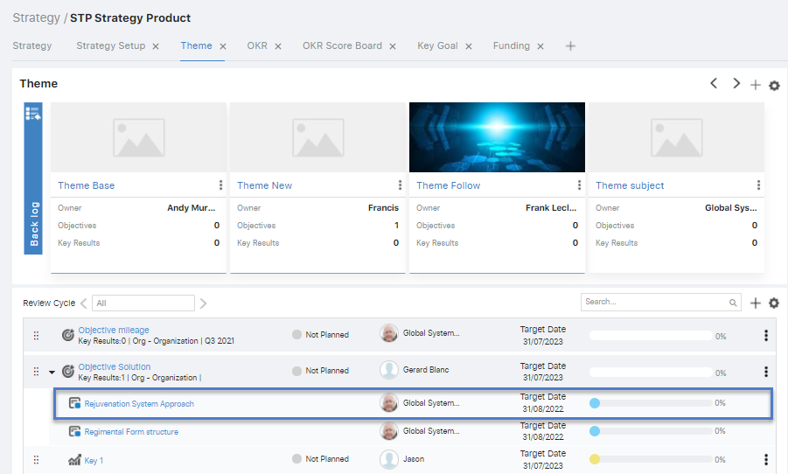
Item linking with Strategy
The Item which are linked with strategy through strategy mapper can be viewed over the Theme layout in the objective grid with which it is associated.

Slide 31
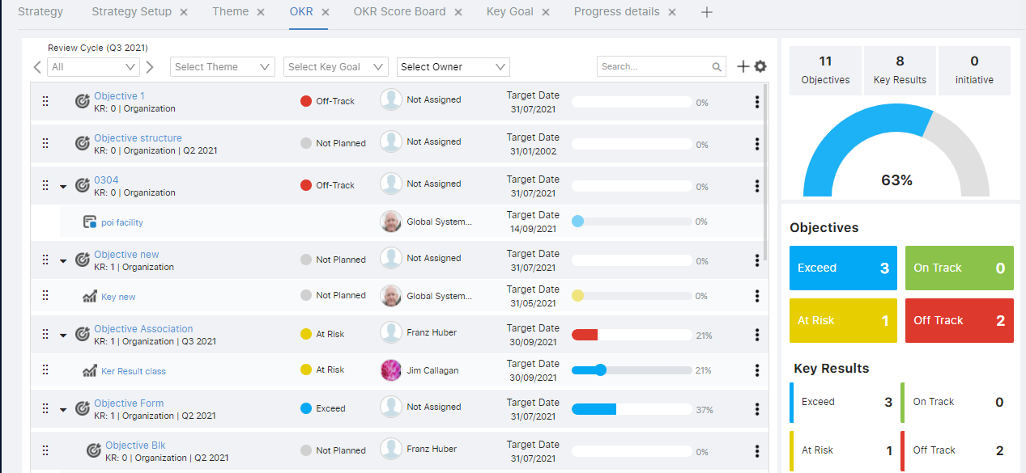
When the All filter is selected it shows the values of the active quarter in the strategy.
Strategy OKR
In the OKR layout, the objectives, key results and projects are displayed as per the quarter selection and for the same the data is displayed in the charts at the right side.

Slide 32
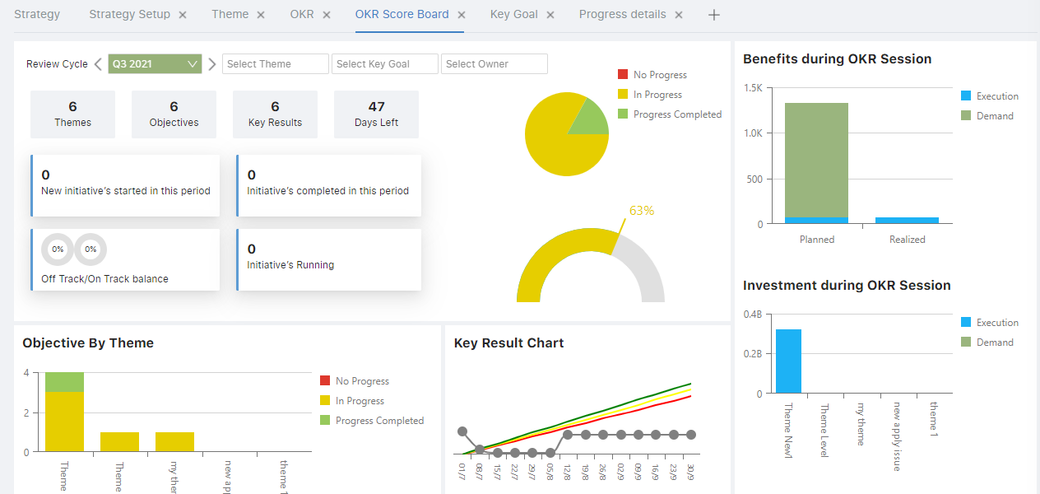
Strategy – OKR Scoreboard
All the data that is added over the respective quarter cycle will be displayed in the charts including the data of the projects that is associated with the respective strategy.
These are the details displayed in OKR scoreboard as per the quarter cycle selected-
Initiatives details
Objectives by Theme
Objective progress
Average Objective progress
Key result chart
Benefits during that period
Investment during that period

Slide 33
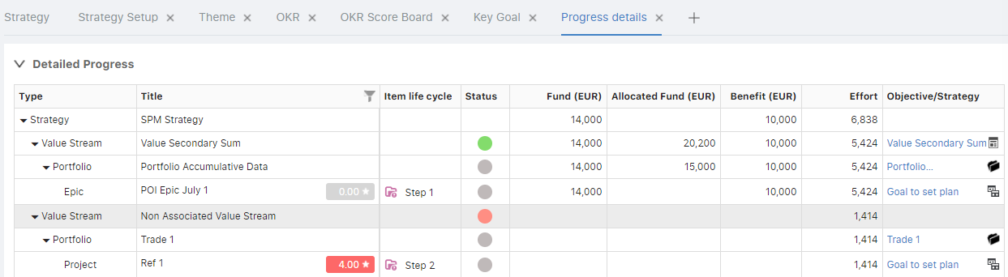
Strategy Detailed Progress
With a particular strategy, the portfolio and the associated all items with it can be viewed in the detailed progress layout.

Slide 34
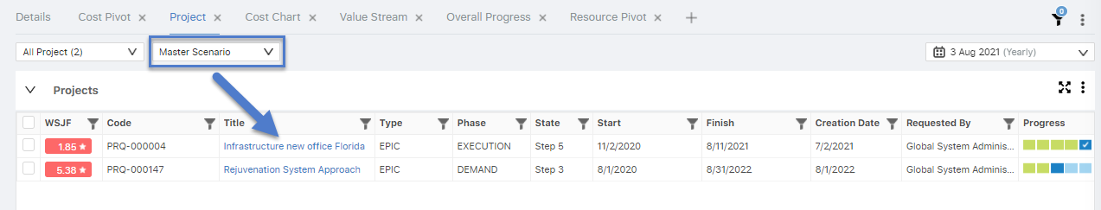
Portfolio - Master Scenario
In the portfolio, when the items are added over the same, it gets associated in master scenario. Existing or new items can be included in the master scenario and also can be removed from the same.

Slide 35
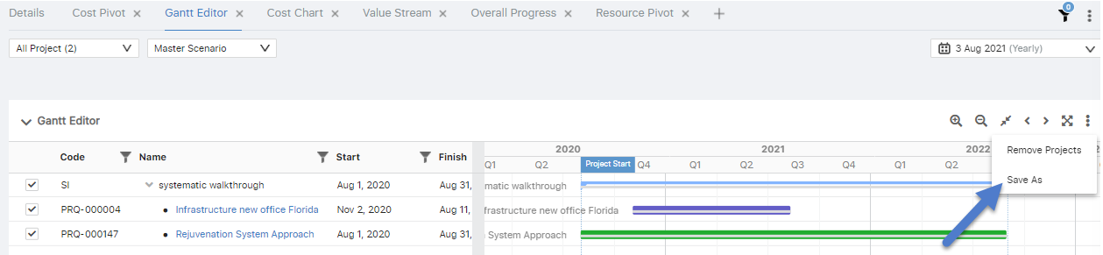

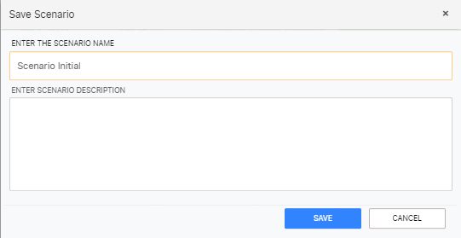
Portfolio - Scenario Creation
For creating multiple scenarios, in the portfolio the user can over the Gantt layout create a new scenario and add the project as per the preference into the same. Same projects in different scenarios with different data can be associated in the scenario.

Slide 36
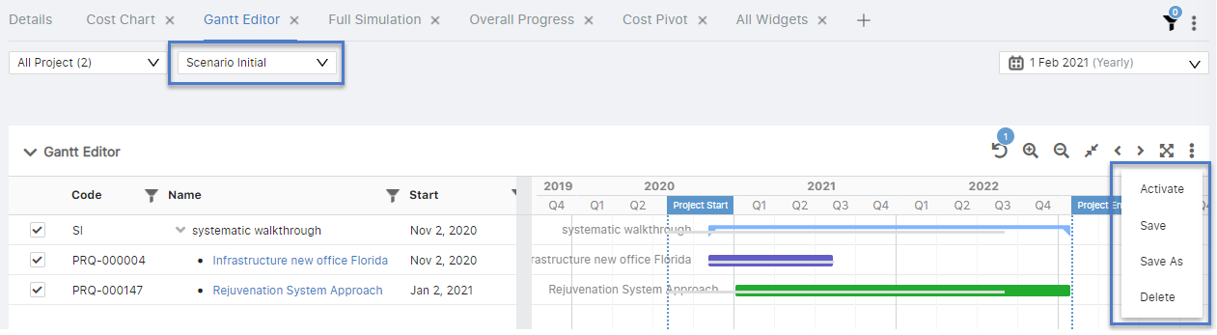
Portfolio - Scenario Creation
Over the created scenario, the user can add/remove the projects as well as activate any scenario as well to display its cost and resource data accordingly for the portfolio

Slide 37
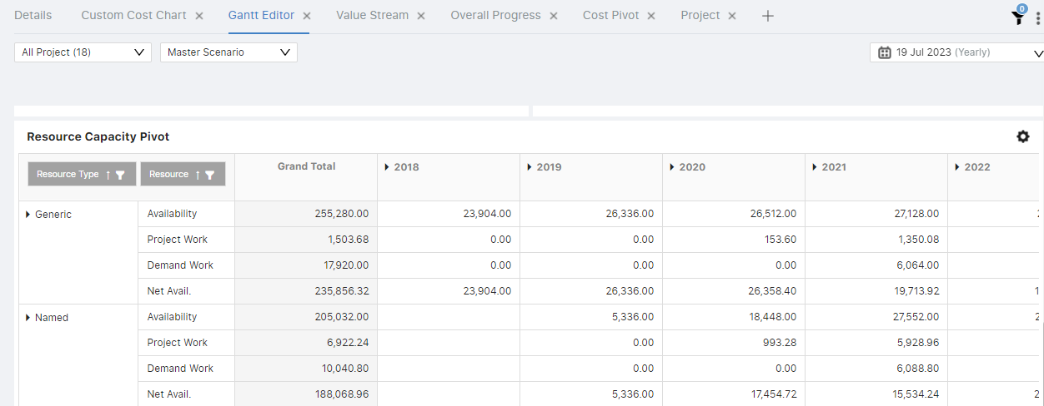
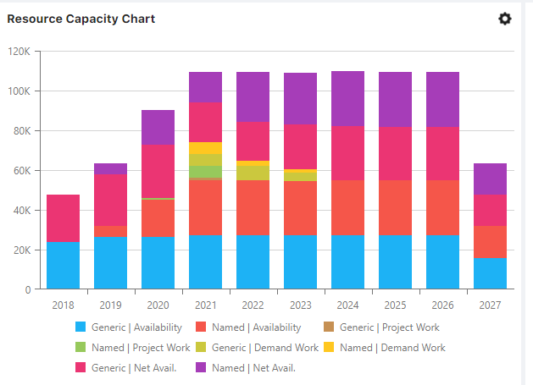
Item Resource Simulation in Portfolios
Now, the item details which are defined like cost, resource can be look over the respective portfolios of each type i.e., Safe or Traditional respectively.
The details can be looked over the Gantt editor layout where all the project are associated in portfolio are displayed along with it’s cost and resource details.
Resource Data

Slide 38
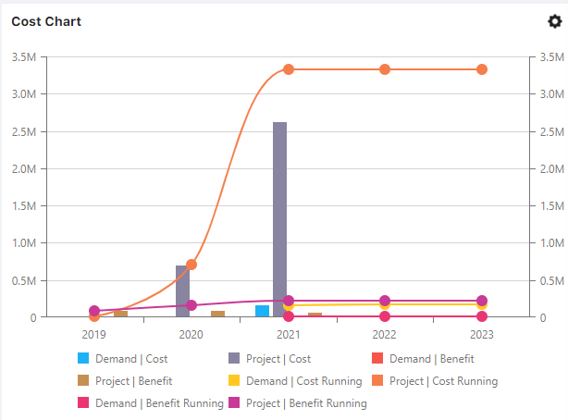
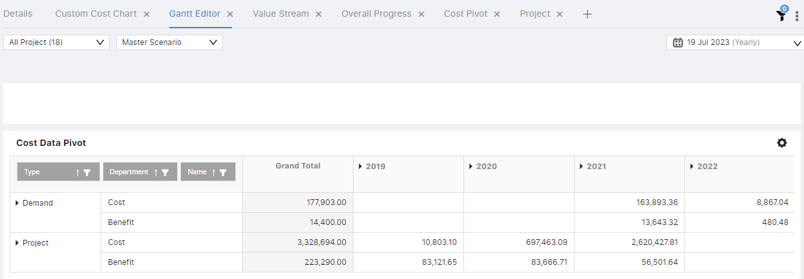
Item Cost Simulation in Portfolios
Now, the Item details which are defined like cost, resource can be look over the respective portfolios of each type i.e., Safe or Traditional respectively.
The details can be looked over the Gantt editor layout where all the project are associated in portfolio are displayed along with it’s cost and resource details.
Cost Data

Slide 39
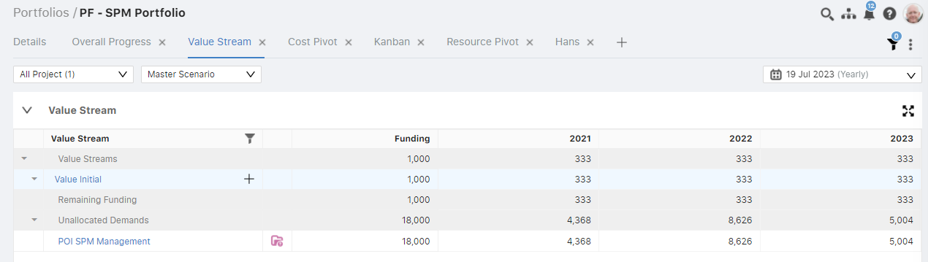
Portfolio – Value Stream
Once the Item is added over the portfolio, the list of items are displayed in the value stream as well with there respective data assigned in the item workspace.
Also, the same value stream is displayed in the grid which is associated with the portfolio in the strategy.

Slide 40

Portfolio – Value Stream to allocate demands
To allocate the item with the value stream in portfolio, the user can click over button to select the item to be added.
Also, the demand should be associated with the same strategy through strategy mapper in which the value stream lies in.

Slide 41



Portfolio – Cost Pivot
When the item is added over the portfolio the same data can be looked over the Cost pivot grid and the value stream data can be looked over the cost chart.

Slide 42

Portfolio – Resource Pivot
When the item is added over the portfolio the same data can be looked over the Resource pivot grid and there are different views for viewing the data over the same chart.

Slide 43

Portfolio – Custom Cost Chart
Two types of series can be created over the chart
Cost Analysis for both Cost and Benefit
Funding
Various cost series can be created by the user for cost chart and based upon that the data can be viewed over the same.

Slide 44

Portfolio – Custom Resource Chart
The resource series created over the chart can be viewed in multiple efforts
Hours
Days
Months
Various resource series can be created by the user for resource chart and based upon that the data can be viewed over the same.

Slide 45

Portfolio – Generic Chart
The details of all series of both cost, resource and funding can be applied here from customize pop up and the data for the same is displayed in the pie chart.

Slide 46

Portfolio – Metric
The Metric defined over the portfolio details, the value for the same can be defined as per different projects. Based upon selection of scenarios from quick filter the data can be viewed accordingly.

Slide 47

Portfolio – Strategy Analysis
Over this chart, two types of data can be viewed over the same after applying the settings in customize pop up.
Metrics- The data define over the portfolio details is displayed.
WSJF- All the projects WSJF details associated with portfolio are defined.

Slide 48

Portfolio – Kanban
All the projects which are associated with the portfolio can be viewed over the Kanban layout. Also, different view lanes can be selected to display data accordingly.

Slide 49

The security are the set of permissions that can be associated with the respective users and based upon that the user is able to access the following modules with the full control or read control accordingly.
Security for Roles
Administrative
Strategy
Portfolio
Program
Analytics
Initiatives

